Slide 1
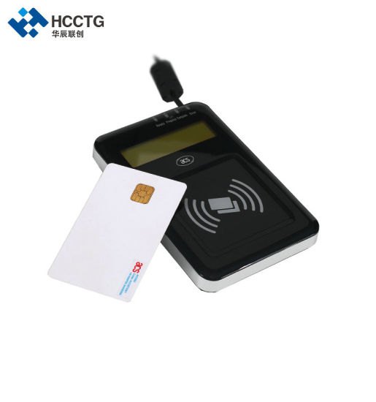
Smart Billing System for Water Suppliers.
Done by:
Team TRIS
K.R Varshitha
Ch. Manasvini Abhigna
B.Ruthvika Rathod

Slide 2
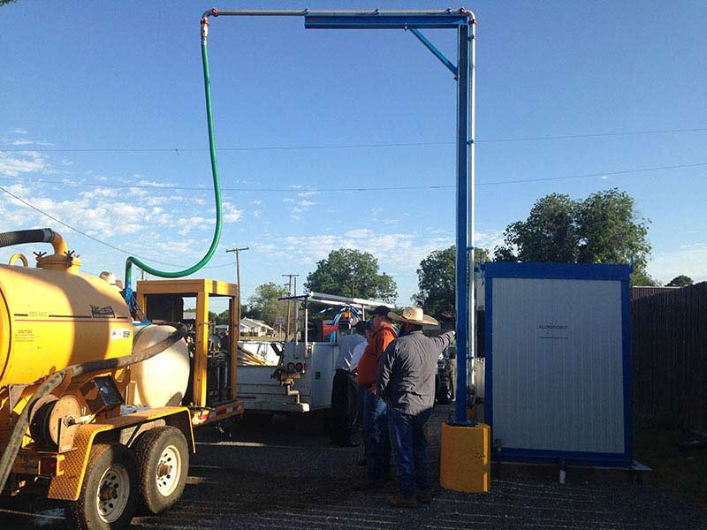
Project Description
Now a day's metropolitan cities operates water tanker service for delivery to residents needing drinking water. Once Water tankers operators get registered with filling stations they get a card issued for payment purposes. Each fill station is equipped with one or more hand-held devices (based on number of pumps in the fill station) which can read/write into a RFID based smart card as well as Wi-Fi modem to communicate with a central server.

Slide 3
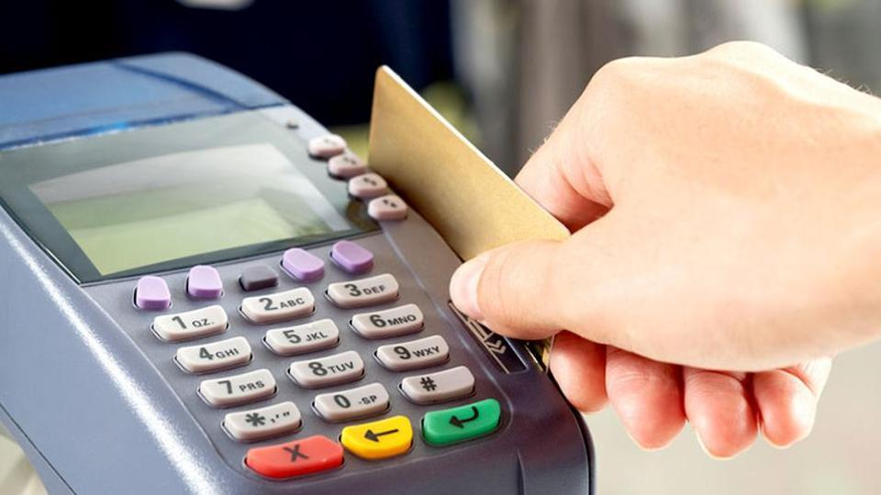
Water tanker supplier, has to tell the requirements before arriving the fill stations. Once this is done (like capacity of water required, area to be delivered) it will be saved in the central server. As the operator reaches he fills the water and swipes the card to the handled device so that the amount gets deducted from the card. If the amount is insufficient in the card a message is displayed on a screen.

Slide 4
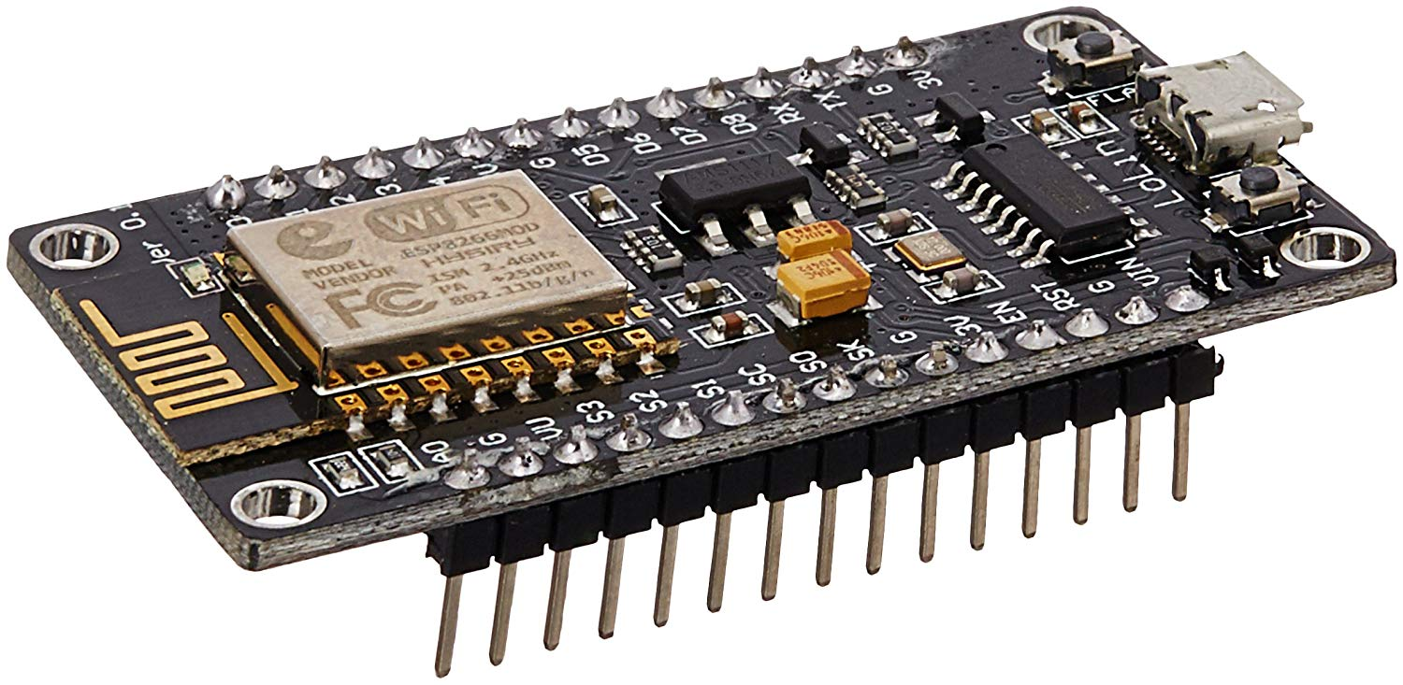
Hardware Used
1. Node MCU(esp8266 Module)

Slide 5
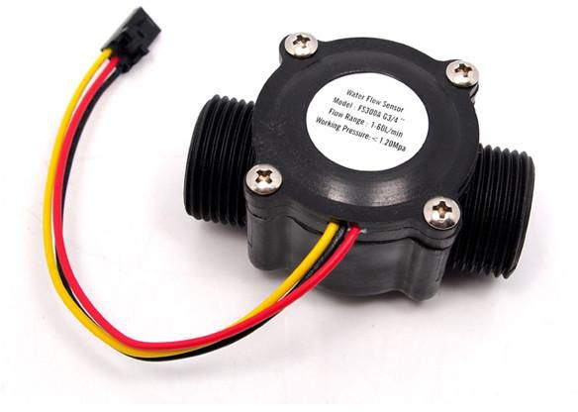
2. Flow Sensor(Operating Voltage : 3-5V)

Slide 6
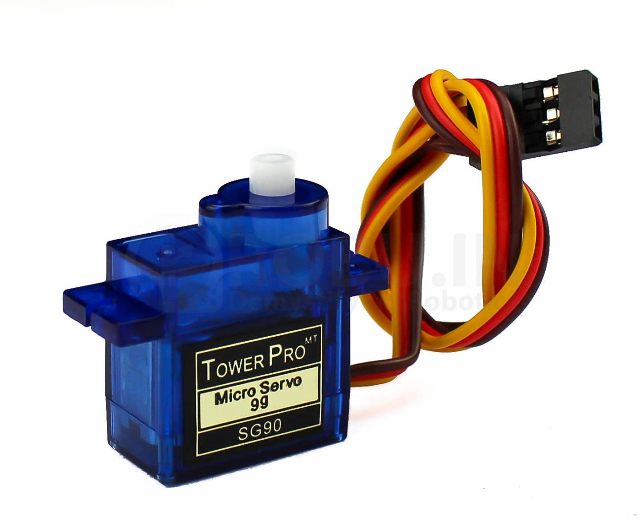
3. Servo Motor (Operating Voltage: 3.3V)

Slide 7
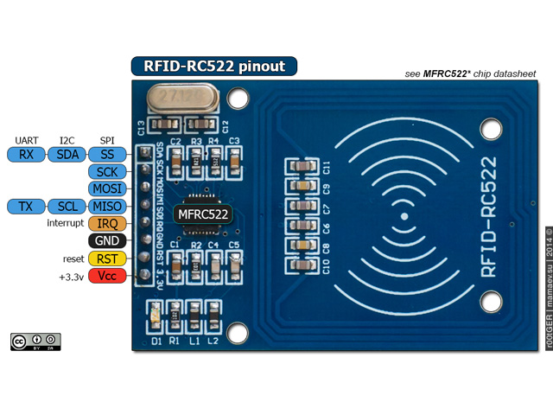
4. RFID Reader (Radio Frequency Identification)

Slide 8
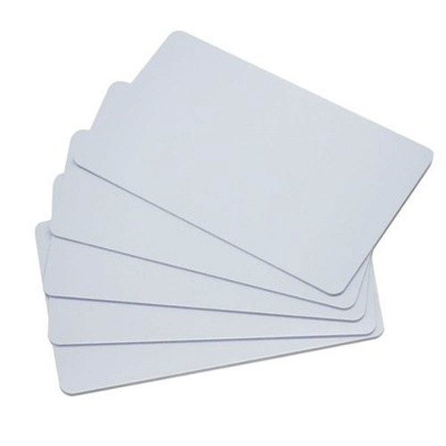
5. RFID cards

Slide 9
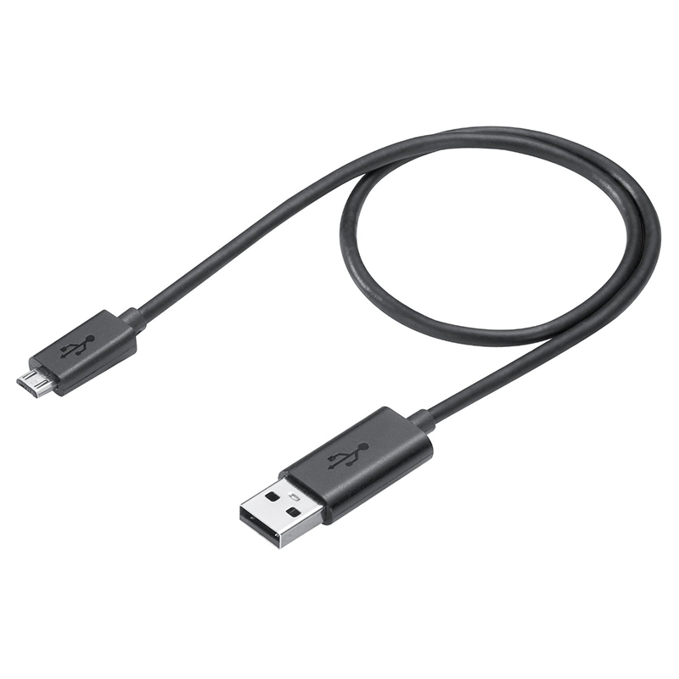
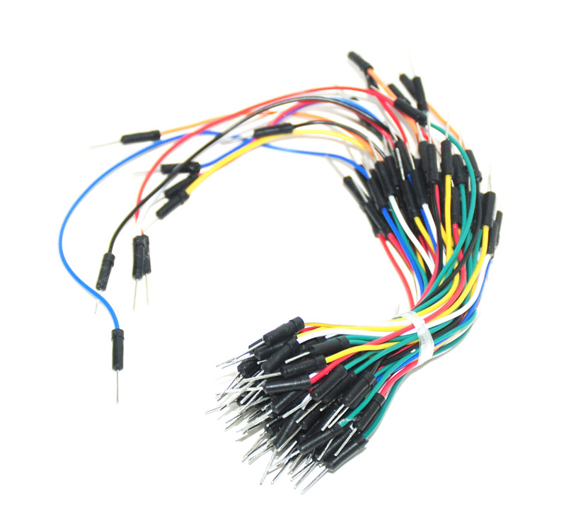
6. USB Cable and Jumpers

Slide 10
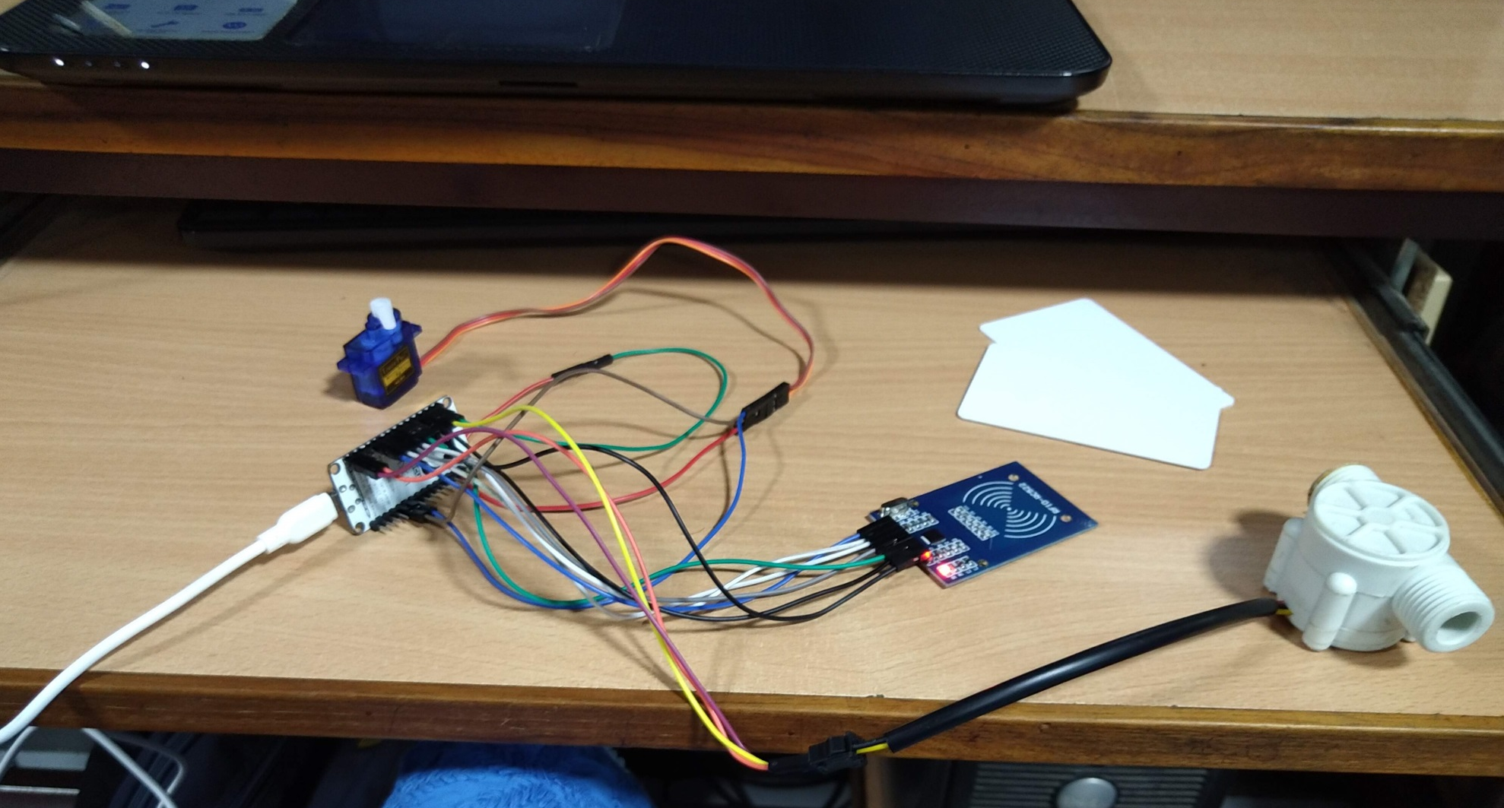
Connections

Slide 11
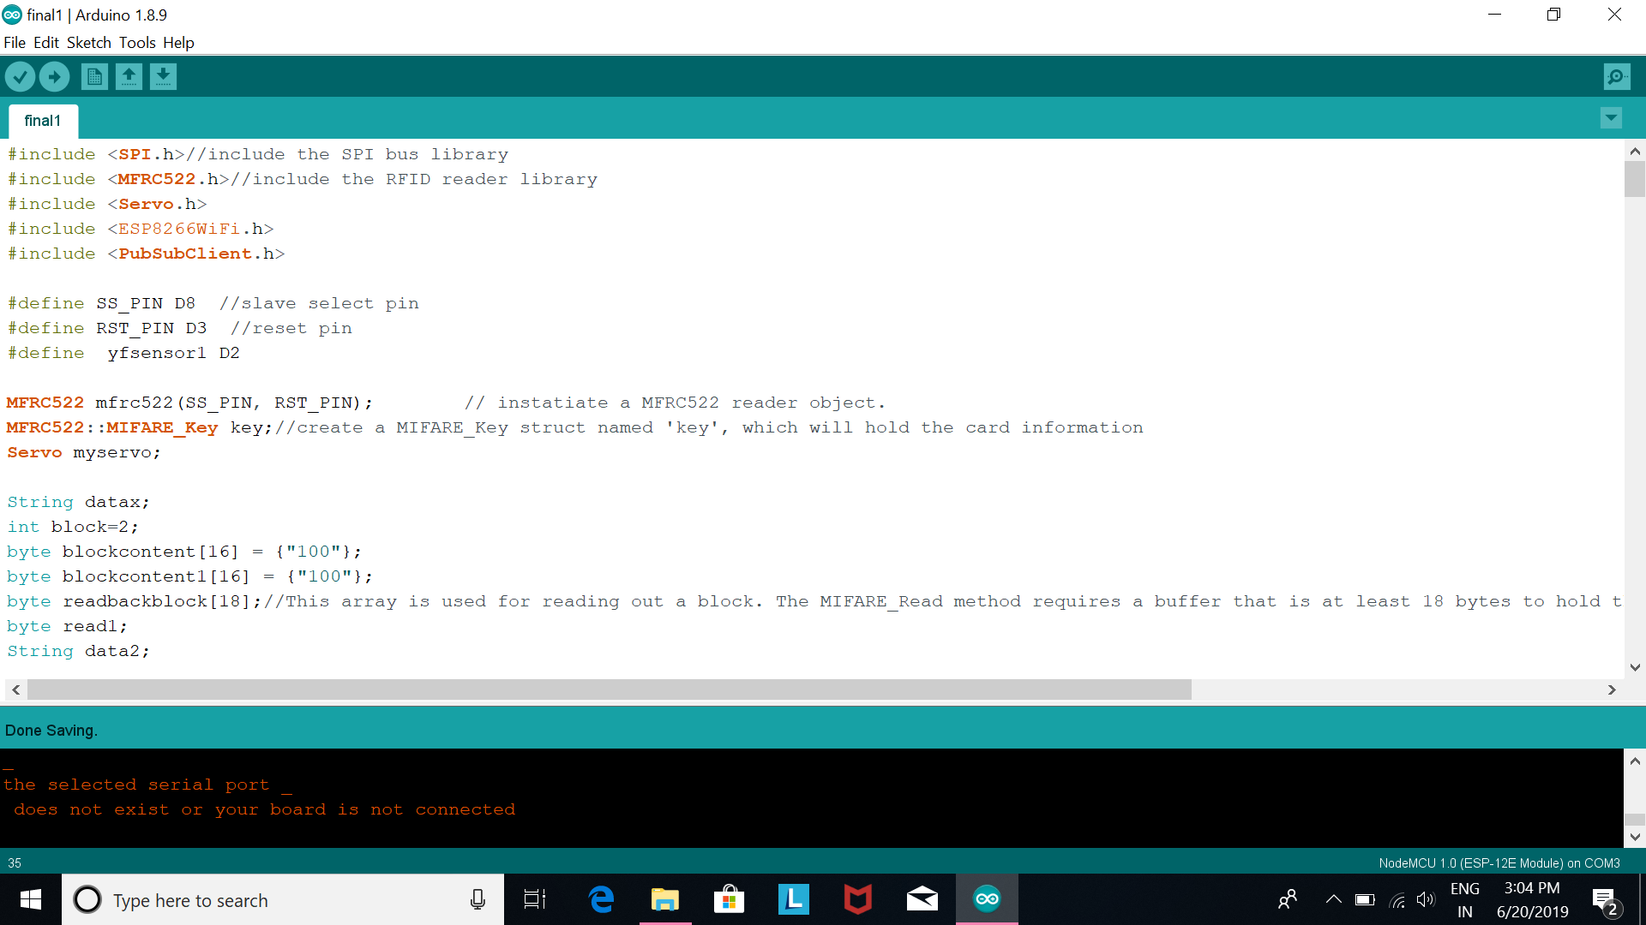
The Following Libraries are to be included:

Slide 12
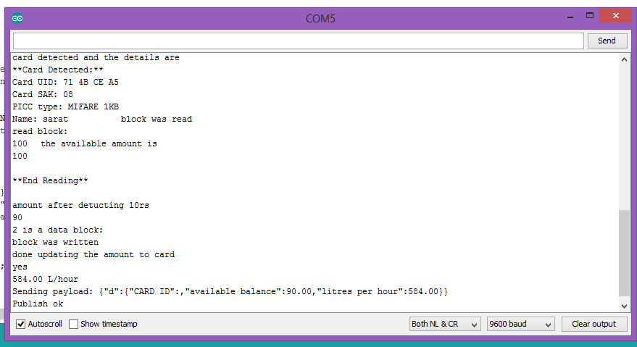
OUTPUT (in Serial Monitor):

Slide 13
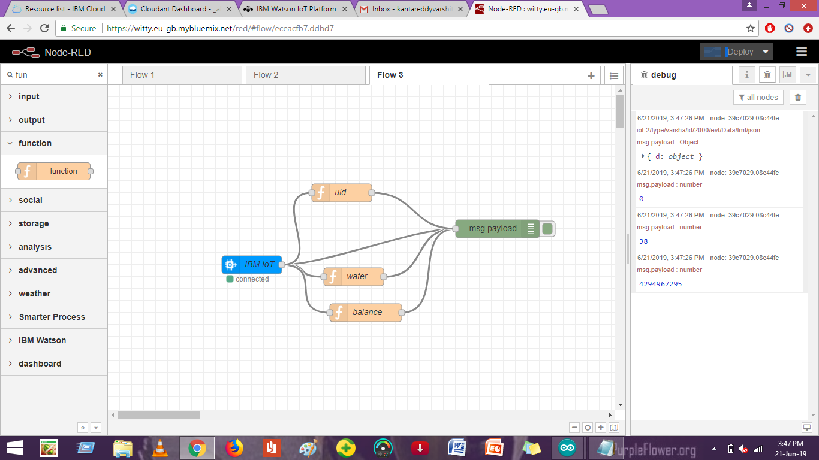
OUTPUT (in Node RED):

Slide 14


